Slide 1
America’s Got Talent
PRESIDENT’S EDITION

Slide 2
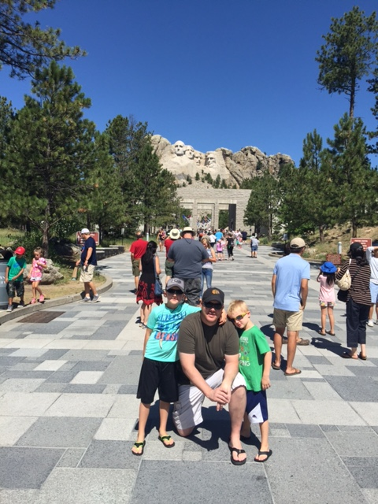
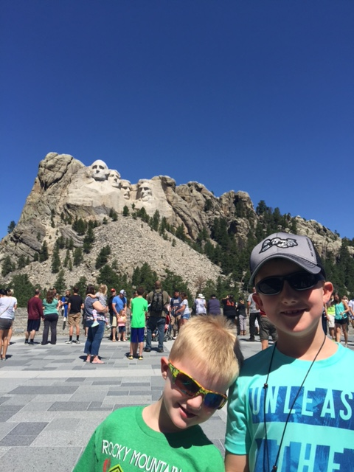

Slide 3
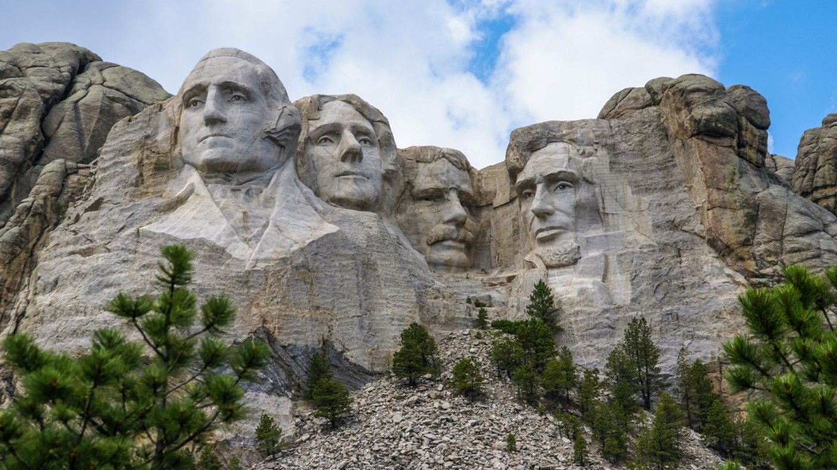
Which President will Win?
1- George Washington
2- Thomas Jefferson
3- Abraham Lincoln
4- Teddy Roosevelt
5- Other?

Slide 4
In groups of 4-5, you will be assigned one of the “big 4”. It will be your job to research, build an argument about why your President should “win”, and present it in class to a panel of judges.

Slide 5
Your mission!
As a group, read through your research packet and highlight all facts/ traits that make your Pres. a stud. What did he achieve? Special talents? Why is his face on the rock?
How will you present this to the class in a way that will convince the judges that you should win? Ideas?...
The winning group will be awarded a valuable prize and 150 Monster Points.

